Slide 1
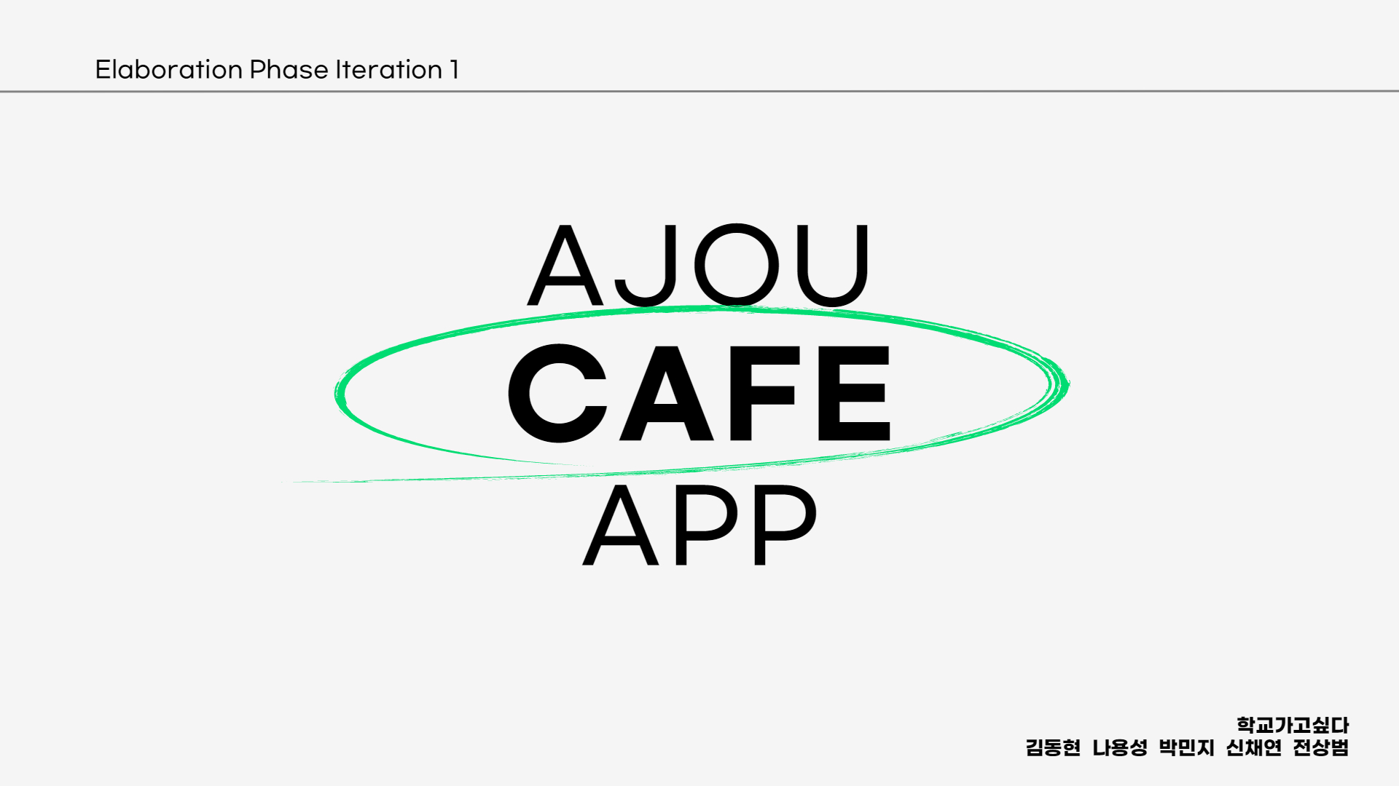
Notes:
안녕하세요 학교가고싶다팀 elaboration phase iteration1 발표자 신채연입니다

Slide 2
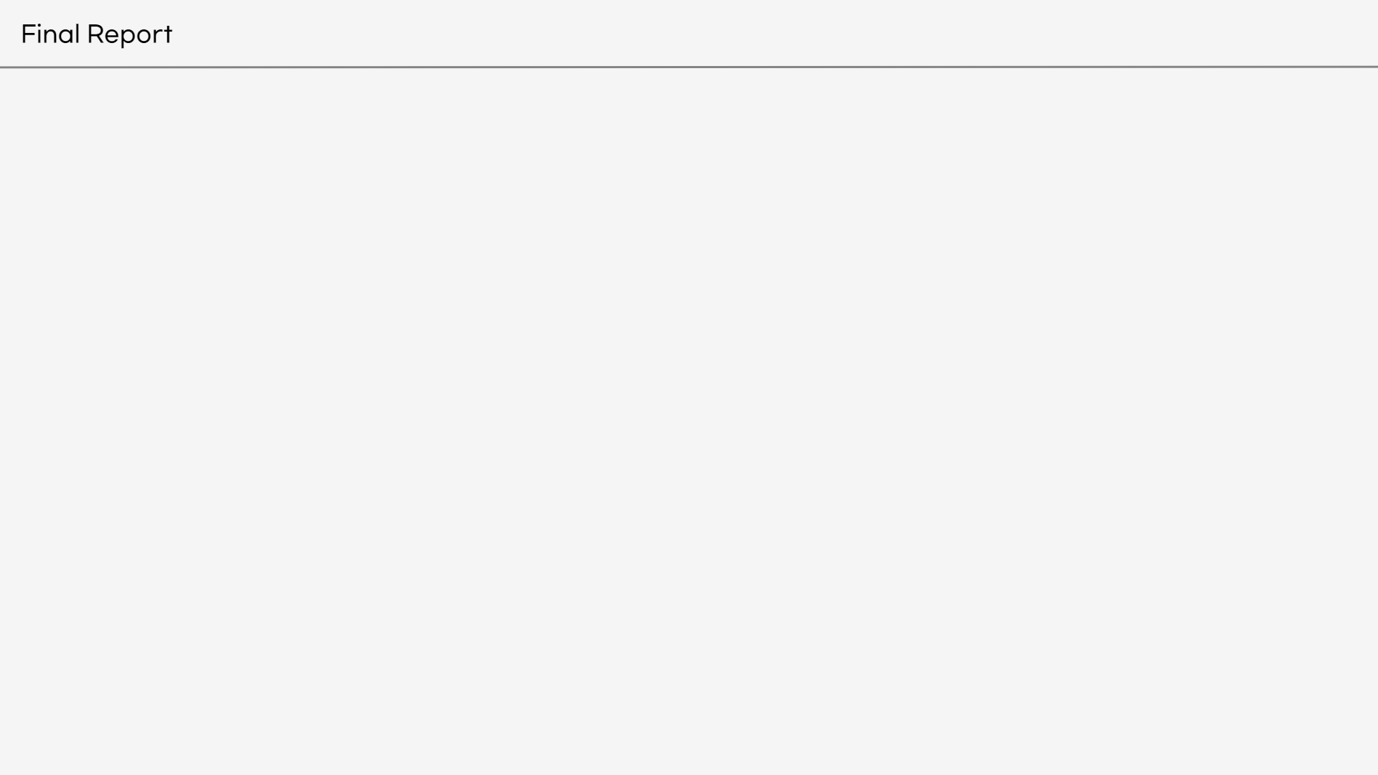
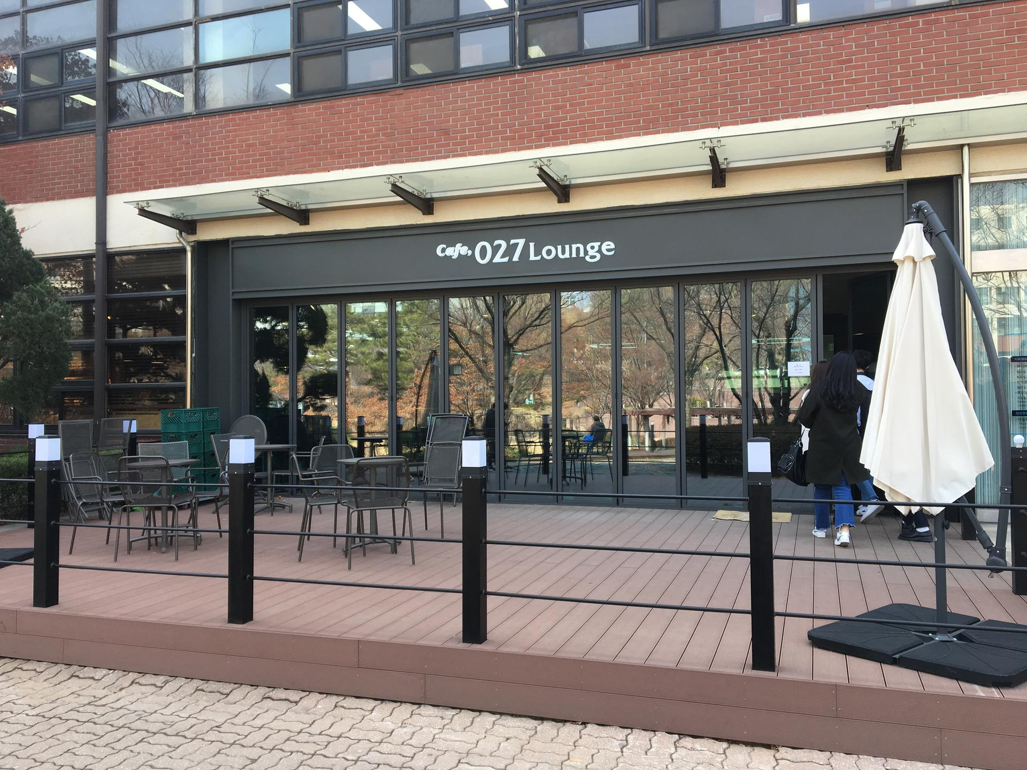
Vision
Notes:
Problem Statement & Solution, Assumptions and Constraints

Slide 3
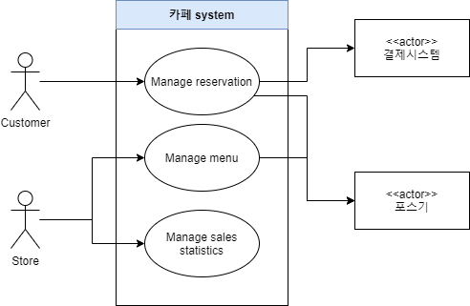
Use case Diagram

Slide 4
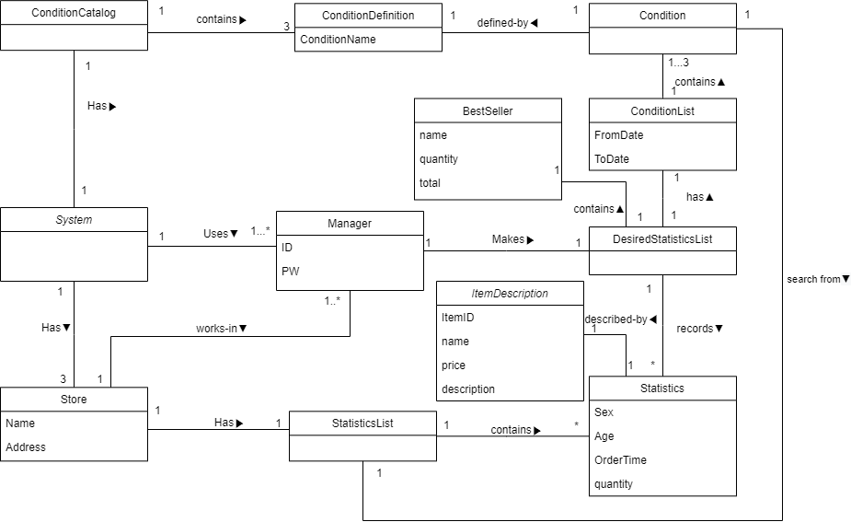

Slide 5
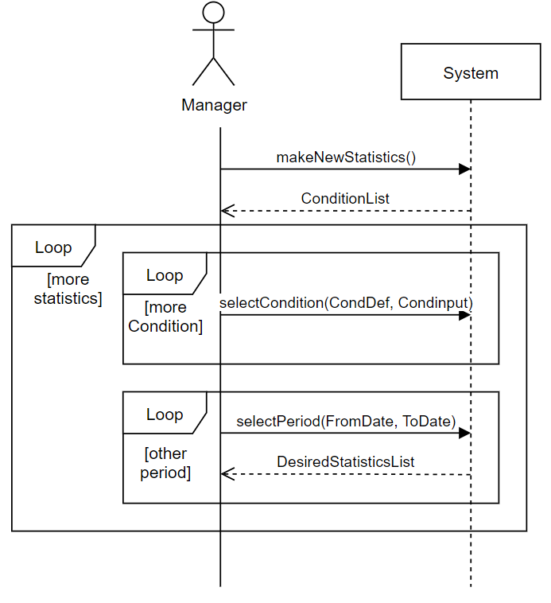
[UC3] System Sequence Diagram

Slide 6
[UC3] Operate Contract
Contract CO1 : makeNewStatistics
Operation : makeNewStatistics()
Cross reference : Manage Sales Statistics
Precondition :
Postcondition :
A DesiredStatisticsList instance dsl was created.
dsl was associated with a System.
A BestSeller instance bs was created.
Attributes of bs were initialized.
bs was associated with dsl.
StatisticsList instance sttList was created.
sttList was associated with dsl.
ConditionList instance CondList was created.
CondList was assciated with dsl.

Slide 7
[UC3] Operate Contract
Contract CO2 : selectCondition
Operation : selectCondition(CondDef : ConditionDefinition, Condinput : String or int or Time)
Cross reference : Manage Statistics
Precondition :
There is a make new Statistics underway.
There is a ConditionDefinition instance CondDef.
Postcondition :
Condition instance cond was created, based on CondDef
cond was associated with CondList.
Contract CO3 : selectPeriod
Operation : selectPeriod(FromDate, ToDate)
Cross reference : Manage Statistics
Precondition :
There is a make new Statistics underway.
There is a StatisticsList instance StoresttList.
Postcondition :
CondList.FromDate became FromDate, CondList.ToDate became ToDate.
Statistics instances in StoresttList were added to sttList, based on CondList.

Slide 8
Software Architecture
Architectural Factors and brief resolutions
Factor | Measures and Quality scenarios | Variability(Current flexibility and future evolution) | Impact of factor(and its variability) on stakeholders, architecture and other factors | Priority for success | Difficulty or Risk
Reliability-Recoverability
recovery from server Failure | The server can be recovered although the server is shut down. | · Current Flexibility : All data must be stored in db. · Evolution : none | During the menu update phase, the server must be accessed and the user must be satisfied with the recovery from the server failure. | H | H
recovery connection with DB | If the connection to the DB is lost, request the connection again within 40 seconds. | · Current Flexibility : Store the latest data before disconnecting. · Evolution : To do recovery, let you have your own DB server. | High impact on the large-scale design. Errors in the DB result in loss of credibility in statistics. Therefore, the value of the application decreases. | H | H

Slide 9
Software Architecture
Architectural Factors and brief resolutions
Factor | Measures and Quality scenarios | Variability(Current flexibility and future evolution) | Impact of factor(and its variability) on stakeholders, architecture and other factors | Priority for success | Difficulty or Risk
Functionality- security
Access to Manager | Users who do not have previous manager certification do not have access to the categories that the manager can access. | · Current Flexibility : Existing users can gain manager access only by registering the store's business license number. | This application is easy for businesses with stores to use this application. | H | L

Slide 10
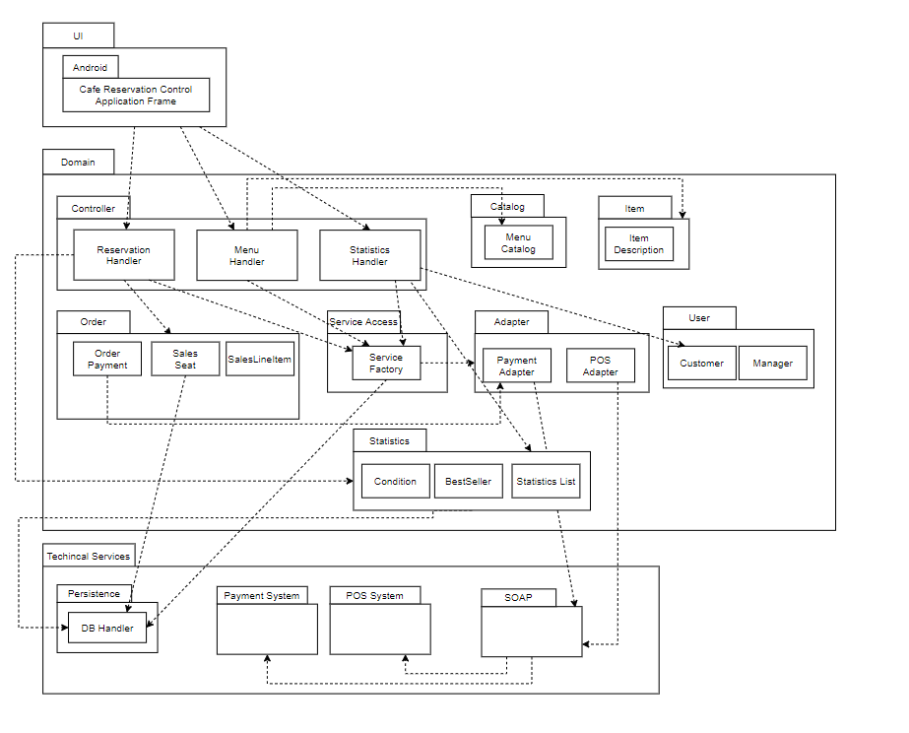
Software Architecture
Logical View

Slide 11
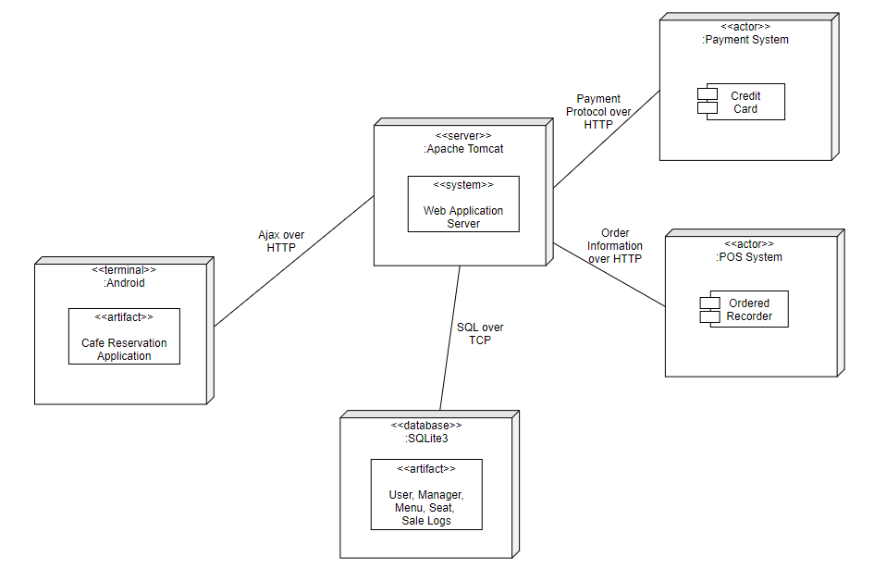
Software Architecture
Deployment View

Slide 12
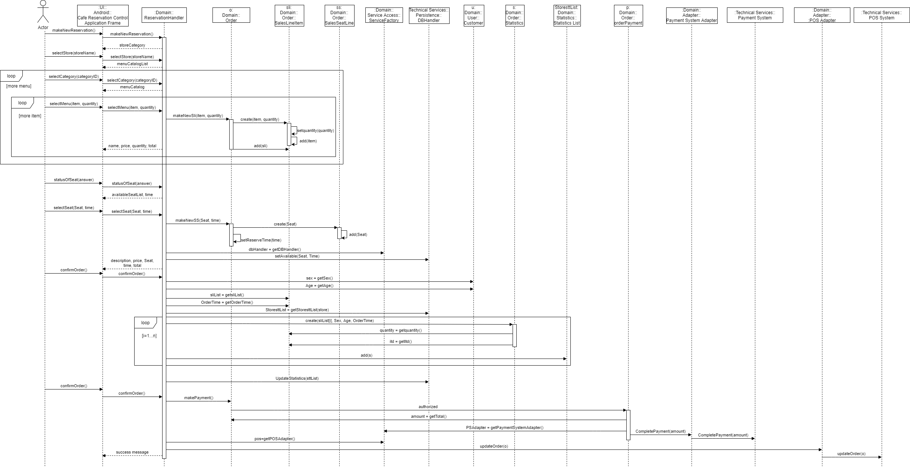
Software Architecture
Use case View

Slide 13
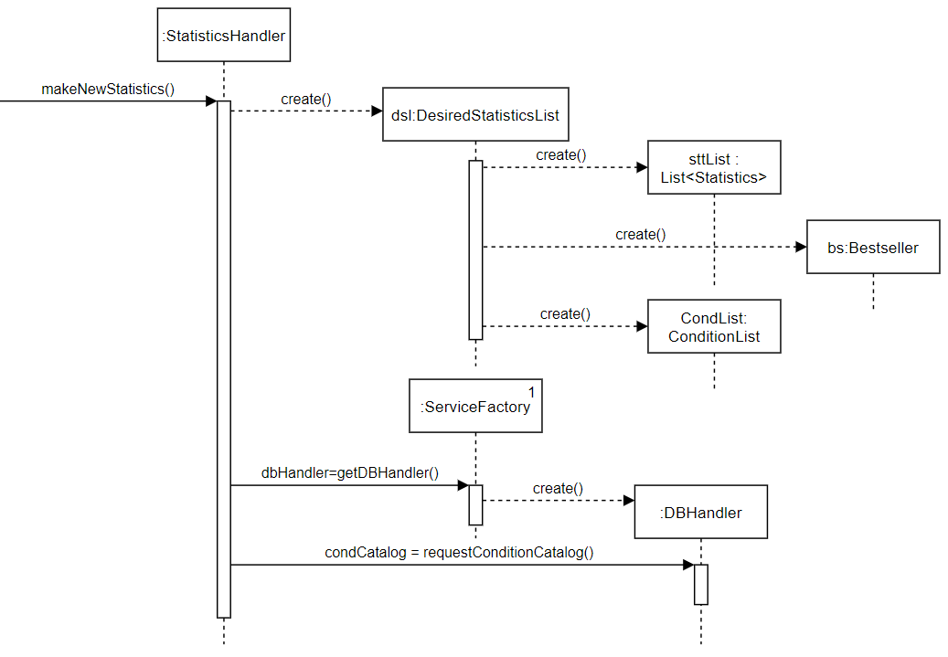
[UC3] Operate ContractSD 1 :makeNewStatistics()
Notes:
reservation핸들러가 order instance o create

Slide 14
[UC3] Operate Contract 1 :makeNewStatistics()
Grasp Pattern
Controller
- StatisticsHandler creates DesiredStatisticsList. - DesiredStatisticsList creates BestSeller. - DesiredStatisticsList creates StatisticsList.
Creator
- StatisticsHandler is first object beyond the UI layer receives and coordinates a system operation.

Slide 15
[UC3] Operate Contract 1 :makeNewStatistics()
GoF Pattern
Facade
- StatisticsHandler is a Facade Controller.
Factory
- Service Factory creates DBHandler.
Singleton
- Service Factory creates the factory itself.

Slide 16
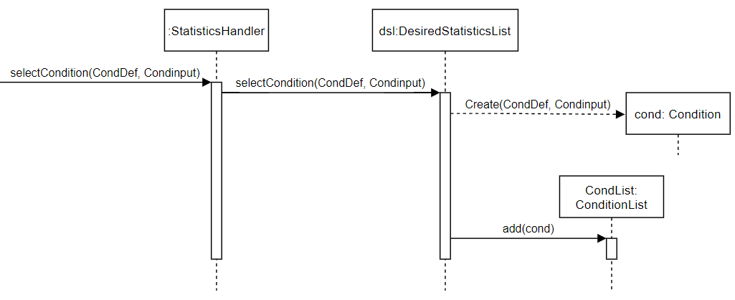
[UC3] Operate ContractSD 2 :selectCondition(CondDef,Condinput)
Notes:
reservation핸들러가 order instance o create

Slide 17
[UC3] Operate ContractSD 2 :selectCondition(CondDef,Condinput)
Grasp Pattern
Creator
- DesiredStatisticsList creates a Condition instance.
Controller
- StatisticsHandler is first object beyond the UI layer receives and coordinates a system operation.
Information Expert
- DesiredStatisticsList knows Condition.
Low Coupling
- System delegates the create Condition responsibility to the DesiredStatisticsList.

Slide 18
[UC3] Operate ContractSD 2 :selectCondition(CondDef,Condinput)
GoF Pattern
Facade
- StatisticsHandler is a Facade Controller.

Slide 19
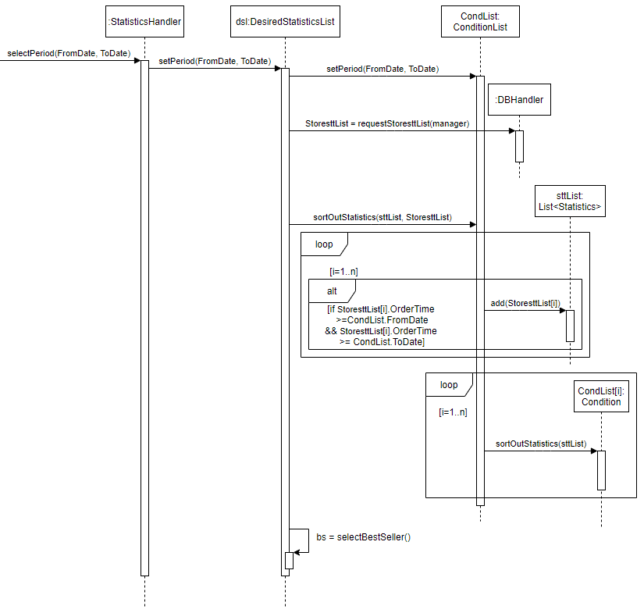
[UC3] Operate ContractSD 3 : selectPeriod(FromDate, ToDate)
Notes:
reservation핸들러가 order instance o create

Slide 20
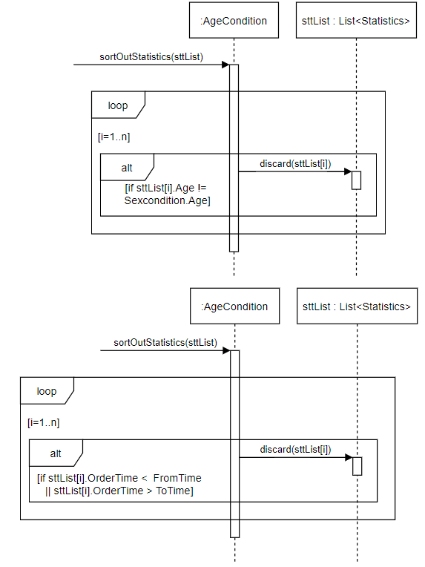
[UC3] Operate ContractSD 3 : selectPeriod(FromDate, ToDate)
Notes:
reservation핸들러가 order instance o create

Slide 21
[UC3] Operate ContractSD 3 : selectPeriod(FromDate, ToDate)
Grasp Pattern
Controller
- StatisticsHandler is first object beyond the UI layer receives and coordinates a system operation.
Information Expert
- ConditionList knows FromDate and ToDate. - DesiredStatisticsList knows sttList.
Low Coupling
- DesiredStatisticsList does not need to know how to get StatisticsList.

Slide 22
[UC3] Operate ContractSD 3 : selectPeriod(FromDate, ToDate)
Grasp Pattern
High Cohesion
- DesiredStatisticsList select its own BestSeller.
Polymorphism
- Condition is a base class for different modes of sortOutStatistics.
GoF Pattern
Facade
- StatisticsHandler is a Facade Controller.

Slide 23
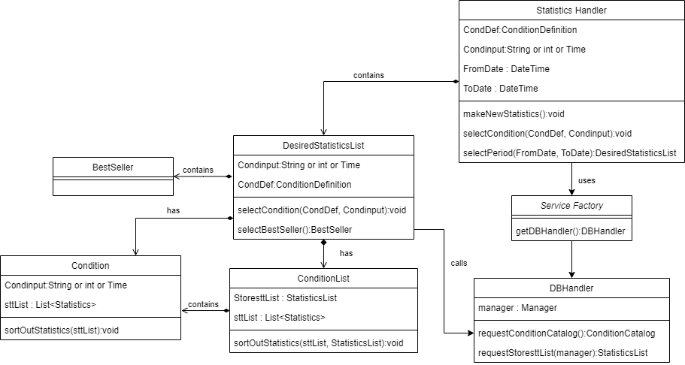
Managed Sales Statistics DCD

Slide 24
Current Status
Design and Analysis
 | Function | percent
Use Case 1 | Select Menu | 100%
 | Select Seat | 100%
 | Select time | 100%
 | Modify Reservation | 100%
 | Cancel Reservation | 100%
Use Case 3 | Select Conditions | 100%
 | Search Date | 100%
 | Show results and best | 100%
Use Case 2 | Add Menu | 100%
 | Delete Menu | 100%
 | Modify Menu | 100%

Slide 25
Current Status
Implementation
 | Function | percent
Use Case 1 | Select Menu | 100%
 | Select Seat | 80%
 | Select time | 100%
Use Case 3 | Select Conditions | 100%
 | Search Date | 100%
 | Show results and best | 100%
Use Case 2 | Manage Menu | NONE
Notes:
select seat 80%인 이유는 좌석 개수를 다 구현한 게 아니라 개수를 최소한으로 보여줘서입니당

Slide 26
Changes and Lessons
Changes
-Create Use case 3 (oc, dcd, ssd …)
-Reorganize Use case 1 (analysis modeling, design modeling...)
-Reorganize Use case 2 (analysis modeling, design modeling...)
Lessons
Notes:
CHAGNES: 바뀐 게 너무 많아서 ssd, oc이름, dcd 등등 일일이 안 적고 크게 적었어요 이 파트는 저번에 저 발표할 때도 그렇고 다른 조들도 그렇고 그냥 넘어가던 부분이라 괜찮을 거 같아요!
LESSON: 자신이 겪은 경험 중 나중에 다른 사람들이 이런 비슷한 프로젝트할 때 해주고 싶은 조언 있나요? 프로젝트의 부족한 부분이라든가 성공한 부분 모두 좋습니다. 아니면 이것만은 피해라! 이건 따라해라!같은 것들도 좋습니당

Slide 27
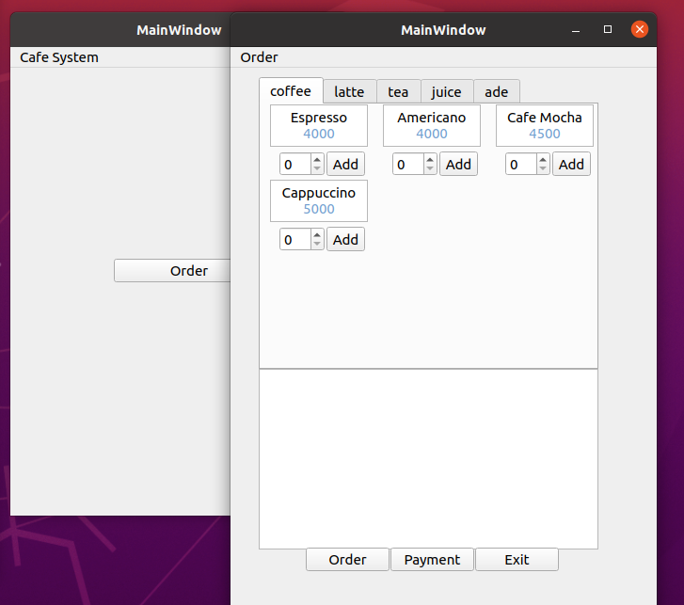
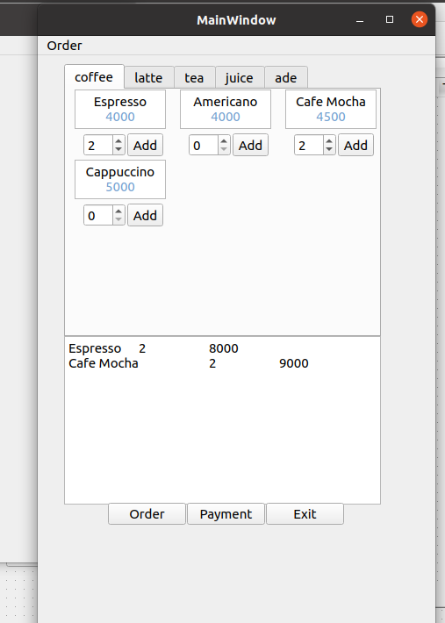
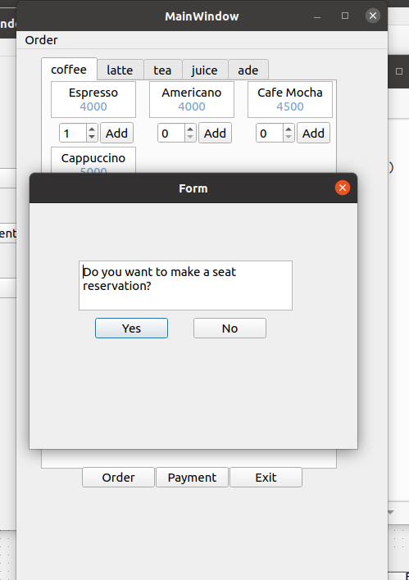
Demo of Prototype
1. 2. 3.
Notes:
프로토타입은 uc1만 보여주는 걸로 했어요!

Slide 28
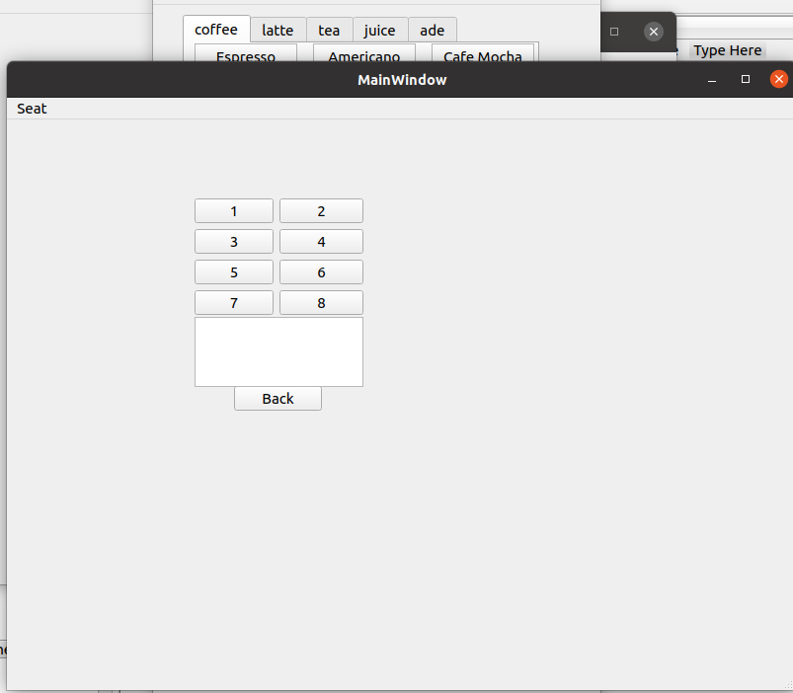
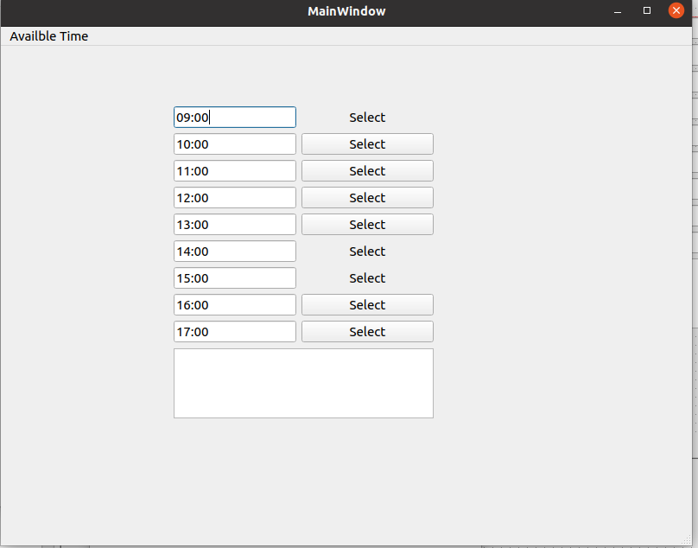
Demo of Prototype
4. 5.

Slide 29
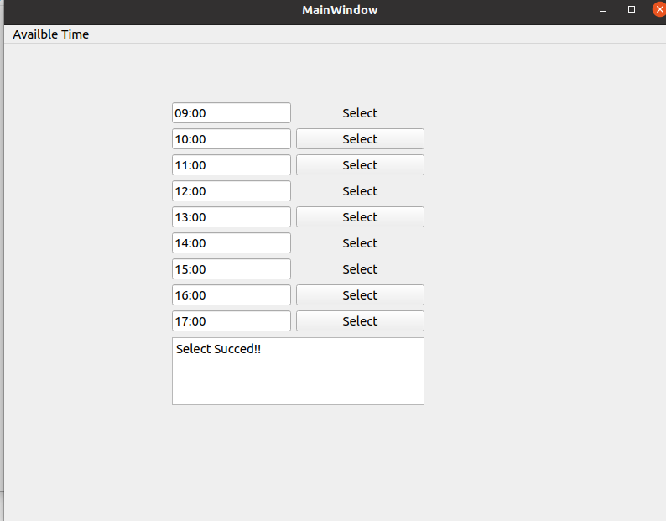
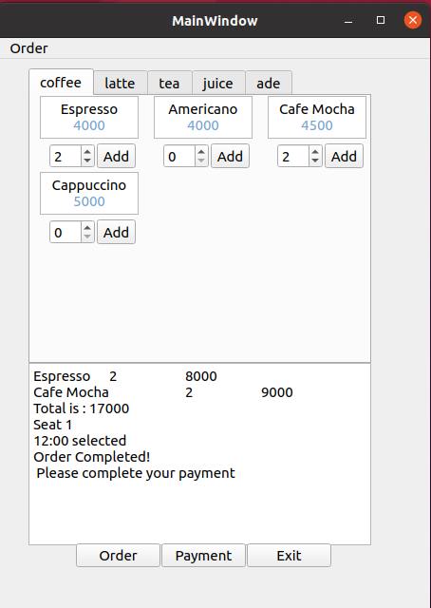
Demo of Prototype
6. 7.

